Slide 1
DEP 202 Data Analysis Cosmopolitan University
DATA ANALYSIS assignment ON EMPLOYEE PERFORMANCE DASHBOARD USING EXCEL.
BY : UCHEGBULEM KELECHI ANNABEL
26A-MED-NSC-0708

Slide 2
Business Objective
The company wants to understand:
Salary distribution
Department performance
Employee distribution by location
Relationship between salary and performance
Workforce structure

Slide 3
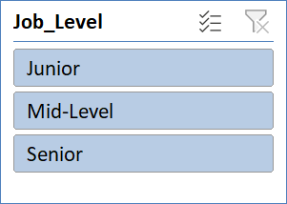
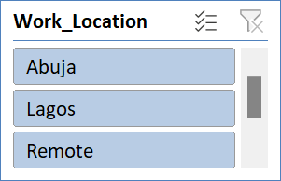
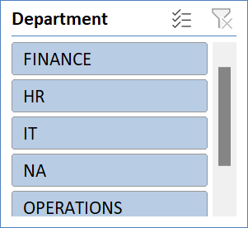
 |  |  |  |  |  |  |  |  | 0
 |  |  |  |  | 838877.7
EMPLOYEE PERFORMANCE DASHBOARD
Maximum Monthly Salary
Minimum Monthly Salary

Slide 4
1. Salary Distribution
The junior staff has the highest salary distribution of 33 workers. Leaving senior staff with 26, and mid-level staff with 25

Slide 5
Department Performance
According to the chart, NA has the least performance of 27.5. Leaving IT department with the highest performance.

Slide 6
Employee Distribution
The chart shows the percentage of workers and the location they work from. The highest workers work remotely and the least workers are working from Lagos

Slide 7
Relationship btw Salary and Performance
The chart shows

